Slide 1
Smart Appointment and Scheduling System for Hospitals
Case Tools Laboratory Project
Haritha Poornachandran - 2017103057
Keerthana Sundaresan - 2017103058

Slide 2
Aim :
To create a system for efficient scheduling and appointments through software along with features for consultation and diagnosis. To reduce congestion by minimizing need for physically booking slots or consulting for minor symptoms.

Slide 3
Project Working
This project uses Java Netbeans to create the frontend of the application. The frontend consists of GUI with which the patient or the doctor can interact with.
It uses MySQL database for the backend services. It stores relevant tables consisting of information on the various classes.
The project allows either patient or doctor to login. Once logged in they can view results schedule appointments, consult online etc.

Slide 4
Modules
Register - (For Patient)
Login - (Patient and doctor)
Homescreen (View details)
Appointment - ( Make appointment and Cancel Appointment)
Online Consultation - ( Patient side and Doctor Side)
Scan - (Doctor side : Schedule)
View Results - (Doctor Side)

Slide 5
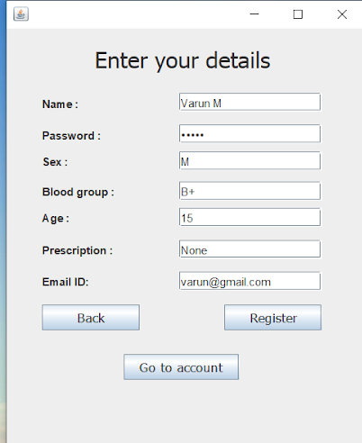
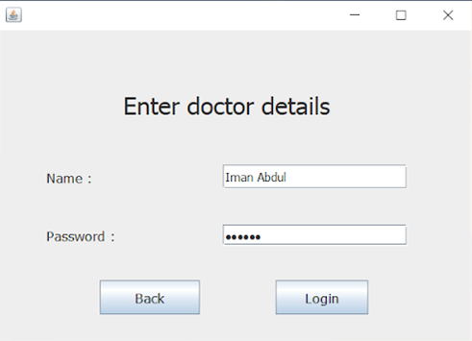
Register:
Registration module. Only available for patient registration. Take in basic details as well as some medical information.
Login:
Available for both patient and doctor. Used to log into respective accounts by use of username and password.

Slide 6
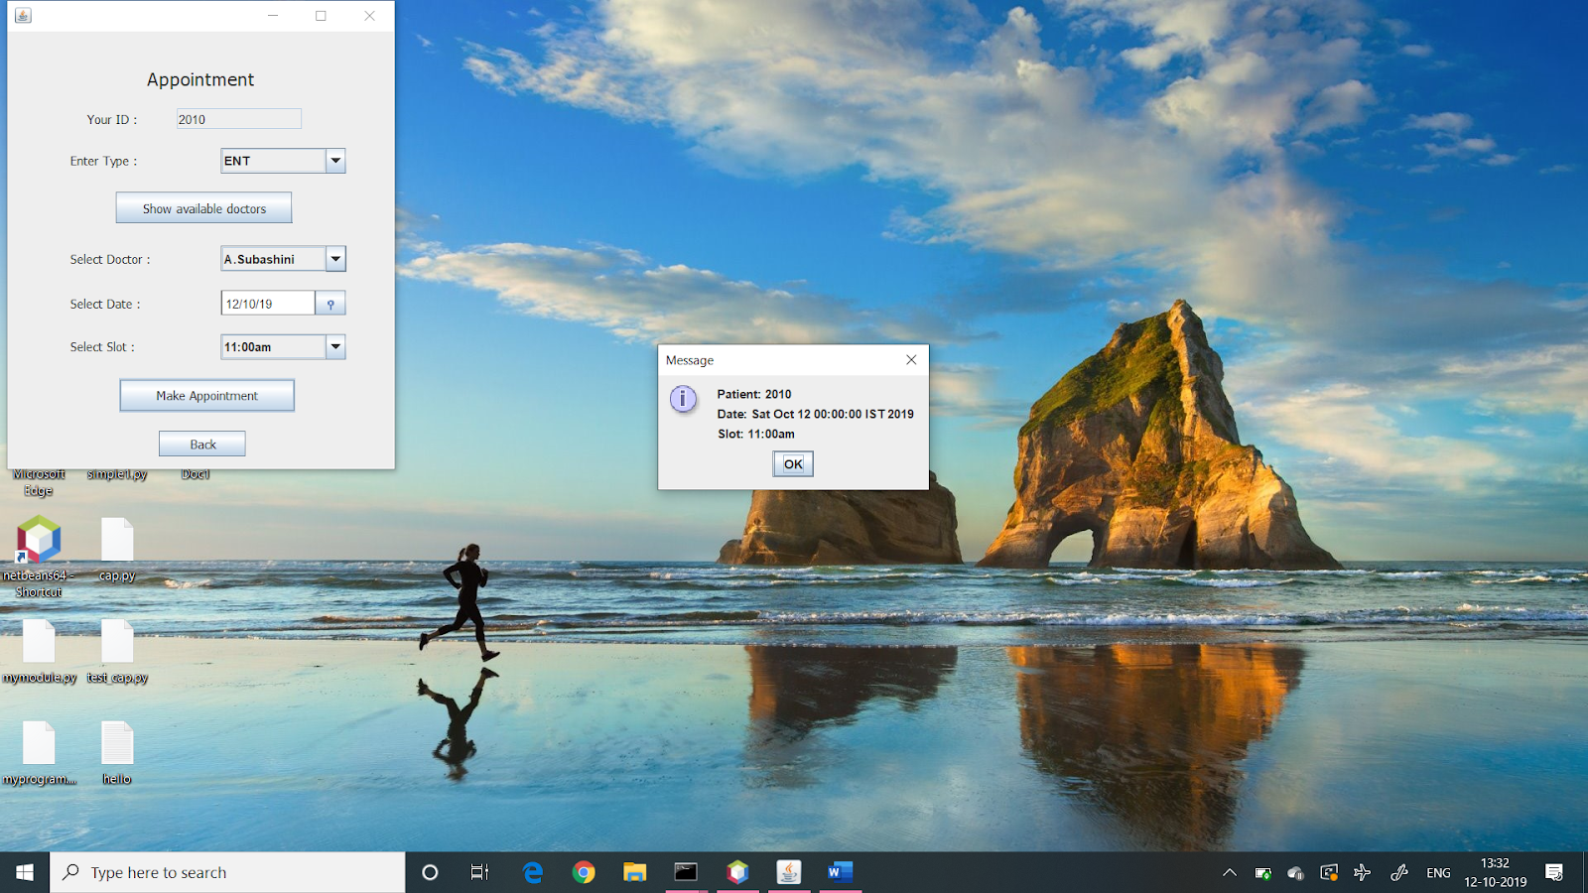
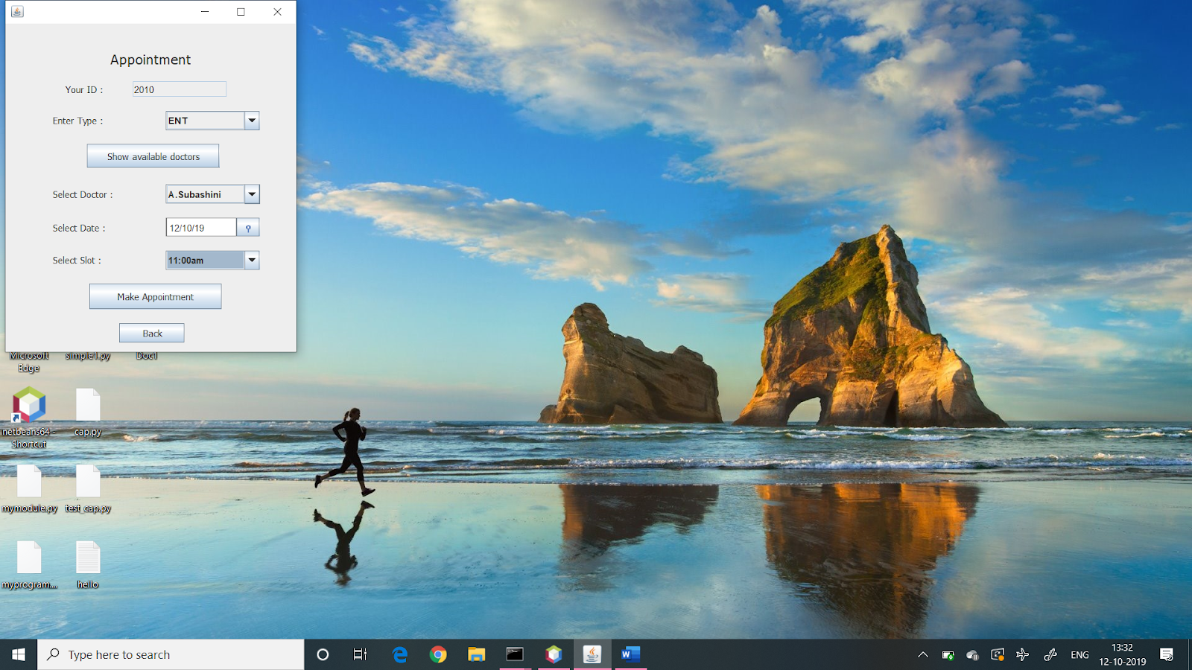
Home Screen:
Main account screen for both patient and doctors. Displays basic information such as name and ID.
Appointment:
Module has 2 parts. Available for patient side. Allows patient to make appointment by selecting type, doctor, date and slot. Prevent double booking. Cancel appointment lets patient cancel pending appointment. Email is sent if appointment is made.

Slide 7
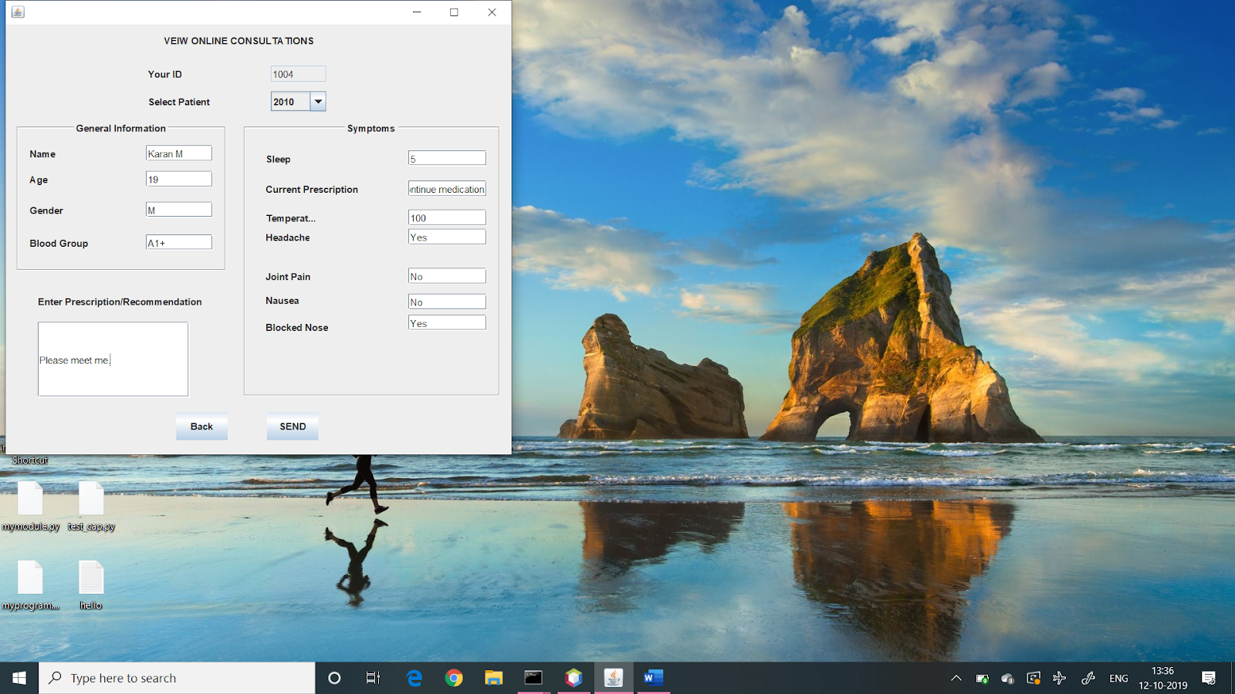
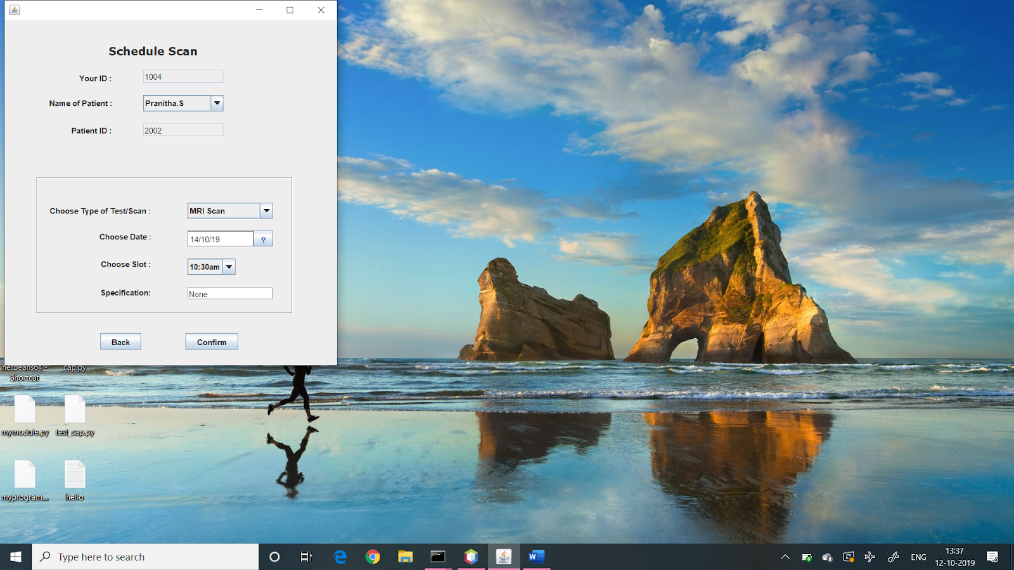
Online consultation:
Patient side: patient intputs details such as temperature and other symptoms and doctor Doctor side: doctor can select one of their patients and view record. Can then provide basic diagnosis and prescription.
Scan:
Scan is on doctor side. Doctor can schedule a scan for one of his patients as required during the appointment according to patients convenience. Email is then sent to patient as reminder.

Slide 8
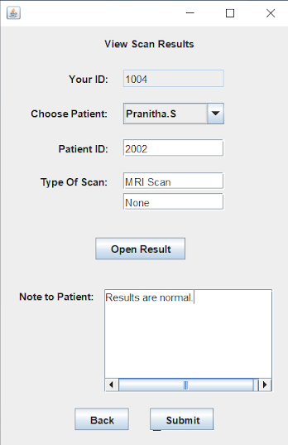
View Results:
Here doctor can open and see the results from scans for any of his patients and can then send condensed version of their diagnosis or suggestion for further action by mail.
Result:
In this way the project is implemented.

